Slide 1




Telecom Customer Churn Analysis
Presentation by Ujjwal Thakur

Slide 2
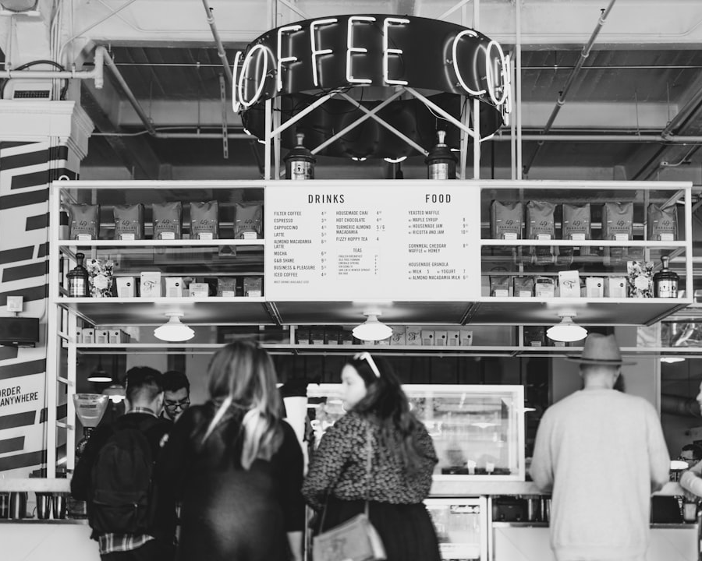
Background Overview
Understanding Customer Churn
Customer churn is a significant issue for the telecom industry, particularly within a California-based company serving over 7000 customers. This analysis explores the factors behind customer attrition, delving into demographic, geographic, and service usage insights to identify patterns and causes contributing to churn. Understanding these issues is critical for developing effective retention strategies and improving overall customer satisfaction.

Slide 3

Project Scope
Project Objectives
Project Constraints
The primary objective of this project is to investigate the factors contributing to customer churn in the telecom industry. By leveraging extensive data, the goal is to uncover actionable insights that the marketing and customer service teams can utilize. Additionally, addressing churn will enhance customer satisfaction and potentially stimulate growth.
Constraints of the project include the availability and quality of customer data, which may be impacted by incomplete records or inconsistencies. Furthermore, collaboration with various stakeholders can introduce challenges in aligning priorities and implementing strategies effectively. These limitations must be acknowledged and carefully managed throughout the project.

Slide 4

Data Cleaning Process
Data Collection
Data Wrangling
Data Merging
The initial step involved gathering relevant customer data, including demographics, service usage, and churn status. This information was essential for a thorough analysis of customer behavior and potential churn factors.
Next, data wrangling techniques were applied to preprocess the dataset. This step included handling missing values, removing duplicates, and correcting inconsistencies that could skew the analysis results. Accurate data representation is crucial for the integrity of the findings.
Following wrangling, various datasets were merged and joined to create a comprehensive view of customer profiles. This process facilitated a more nuanced understanding of how different factors might interplay to affect churn.

Slide 5
Goals & KPIs
Goals
Reduce customer churn by analyzing key dissatisfaction drivers and improving service quality. The focus is on enhancing customer support and addressing pain points to increase long-term retention.
KPIs
Monitor churn rate
customer satisfaction scores,
retention rates.
Total Revenue

Slide 6
Recommended Analysis
Q1. What seems to be the key drivers of customer churn?

Slide 7
Recommended Analysis
Q2. Is the company losing high-value customers? If so, how can they retain them?
Match Competitor Offers: Provide better devices, pricing, and data limits to attract high-value customers.
Improve Customer Service: Train support teams and assign account managers for personalized care.
Loyalty Programs: Offer exclusive deals and early upgrades to reward loyal customers.
Enhance Product Quality: Boost network reliability and product performance to reduce issues.
Flexible Pricing: Offer tiered pricing to suit different customer budgets

Slide 8
Recommended Analysis
Q3. Out of the 3 customer statuses, stayed, churned, and joined, which has the highest %?

Slide 9
Recommended Analysis
Q4. What payment method was preferred by churned users?

Slide 10
Recommended Analysis
Q5. What are the top 12 cities that churned?

Slide 11
Key Findings
Finding | Description | Implication
High Churn in Specific Demographics | Younger customers aged 18-25 showed a 32% churn rate. | Targeted marketing strategies may be required for retention.
Service Usage Patterns | Users with lower data usage are more likely to churn. | Improving service packages for lower usage can enhance satisfaction.
Regional Churn Variations | San Diego and Los Angeles had the highest churn rates. | Localized retention strategies may be necessary.
Key drivers of customer churn | Customers usually churn due to competitors’ better offers & plans. | Evaluate pricing structure and identify areas where you can offer more competitive rates without compromising profitability.

Slide 12
Churn Statistics
67%
27%
6%
Stayed
Churned
Joined
67% of customers remained loyal to the telecom company, indicating a strong base of satisfied users. This group reflects successful retention strategies already in place.
27% of customers have churned, revealing significant attrition challenges. Understanding the reasons behind this churn is essential for developing targeted retention strategies.
6% of customers are new, signaling an opportunity for growth. Focusing on converting new customers into loyal users can help mitigate churn issues.

Slide 13

Retention Strategies
Immediate Actions
To reduce churn, immediate actions might include enhancing customer service, offering competitive promotions, and implementing loyalty programs for high-risk customers. Personalized engagement is key to customer retention.
Long-term Strategies
Long-term strategies should focus on improving service quality and customer experience. Investing in network reliability and developing flexible pricing models can significantly contribute to customer satisfaction and loyalty.

Slide 14




Project owner: Ujjwal Thakur
Do you have any questions?
: www.linkedin.com/in/ujjwal-thakur-b41525287
: https://github.com/Ujjwalthakur018
: thakurujjwal1812

